Slide 1
Strategic Plan Update 2023 -2024
Sylvan Hills Middle School GO Team Meeting

Slide 2
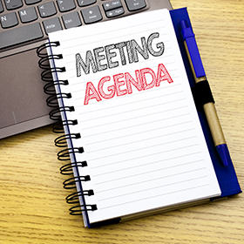
Agenda
Call to Order
Norms
Roll Call
Action Items
Approval of Agenda
Approval of Previous Minutes
Approve Strategic Plan
Ranking the Strategic Plan Priorities
Discussion Items
CIP Plan Check In
Progress on the Strategic Plan Priorities
Strategic Plan Priorities
Information Items/ Announcements
Adjournment

Slide 3
Let’s commit to:
Wearing masks and socially distancing
Being present and engaging meaningfully so that we can learn from each other (i.e. Cameras on)
Refrain from using electronic devices unless required to engage in the work
Muting your microphone (VIRTUAL) and minimizing extraneous conversations
Assuming good will
Allowing all voices of the team to be heard
Focusing on the day’s content
Starting and ending on time
Being gracious

Slide 4
GO TEAM MEMBERS 23-24
NAME | ROLE
Mr. Larry A. Guilford | Principal
Ms. Jessica Bracey | Parent
Ms. Devette Wilson | Parent
Ms. Qiana Gordon | Parent
Ms. Jayla Bailey | Staff
Ms. Diamond Leben | Staff
Ms. Crawley-James | Staff
Mr. Durand Bailey | Community Member
Mr. Tony Owens | Community Member
Ms. Conyashie Jordan | Swing Seat

Slide 5
Action Items
.
Action Items
Approval of Agenda
Approval of Previous Minutes

Slide 6
Strategic Plan Progress

Slide 7
Our Strategic Plan

Slide 8
Action on the Updated Strategic Plan
The GO Team needs to TAKE ACTION (vote) on its updated Strategic Plan. After the motion and a second, the GO Team may have additional discussion. Once discussion is concluded, the GO Team will vote.

Slide 9
Preparing for Budget Development

Slide 10
Discussion
Strategic Plan Priority Ranking
In preparation for the 2024-2025 Budget Development (January–March 2024), the GO Team needs to rank its Strategic Plan Priorities. Use the next slide to capture the priority ranking.

Slide 11
Strategic Plan
Priority Ranking
Insert the school’s priorities from Higher to Lower
Higher
Improve students’ mathematics performance
Improve students’ reading language arts/ writing performance
Regularly engage students in research and reflection on personal data and growth
Provide ongoing professional learning and development opportunities for all faculty/staff
Consistently inform and engage school families, community and partners
Recruit and maintain highly talented faculty/staff
Increase the number of students in higher level and STEM classes
Continuously align people and resources to maximize impact
Lower

Slide 12
Action on the Strategic Plan Priorities
The GO Team needs to TAKE ACTION (vote) on its ranked Strategic Plan Priorities. After the motion and a second, the GO Team may have additional discussion. Once discussion is concluded, the GO Team will vote.

Slide 13
Where we’re going
At our next meeting we will begin the discussion of the 2024-2025 budget.
Let me or the Chair know of any additional information you need for our future discussion.

Slide 14
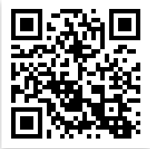
Connect with US!
@apssylvanhillsms
https://www.atlantapublicschools.us/Page/4020
@apssylvanhills

Slide 15
Questions?
Feedback?
Concerns?

Slide 16
Thank you

